Slide 1
Analyzing Plasma evolution with transformers
Supervisor: Anna Braghetto
Members:
Amirhossein Rostami - 2084299
Davide Checchia - 2078232
Jelin Raphael Akkara - 2072064
Kiamehr Javid - 2084294
GROUP 2315

Slide 2
OUTLINE
PROBLEM AND APPROACH OVERVIEW
DATA PREPARATION
VALIDATION AMONG MODEL ARCHITECTURES
IMPROVEMENT OF BEST MODEL
CONCLUSION

Slide 3
i. PROBLEM AND APPROACH OVERVIEW
Introduction to Problem
Transformers
General Approach
Challenges Faced
Methods Used

Slide 4
1. Introduction to the problem
Plasma is confined in a torus, in a helical shape, using strong magnetic fields. Magnetic instabilities can result in magnetic reconnection (crash), which is a current issue in plasma physics.
We are interested in the prediction of crashes, based on the features (e.g. magnetic field instabilities, safety factors) of the system.
From the machine learning perspective, this translates to a binary classification problem with timeseries data. Using a time window of feature values, we need to predict if a crash is going to occur in a given time period.
The instances are time-series of the values of the magnetic instabilities at different positions of a torus. The saw_crash labels simply indicate the presence or absence of a crash.

Slide 5
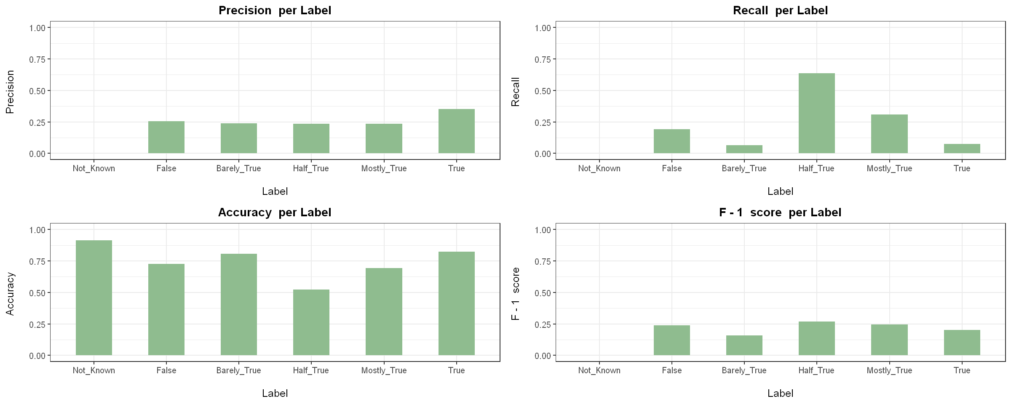
Normalization: Stemming vs lemmatization
STEM: 1, LEM: 0, FEAT: 0

Slide 6
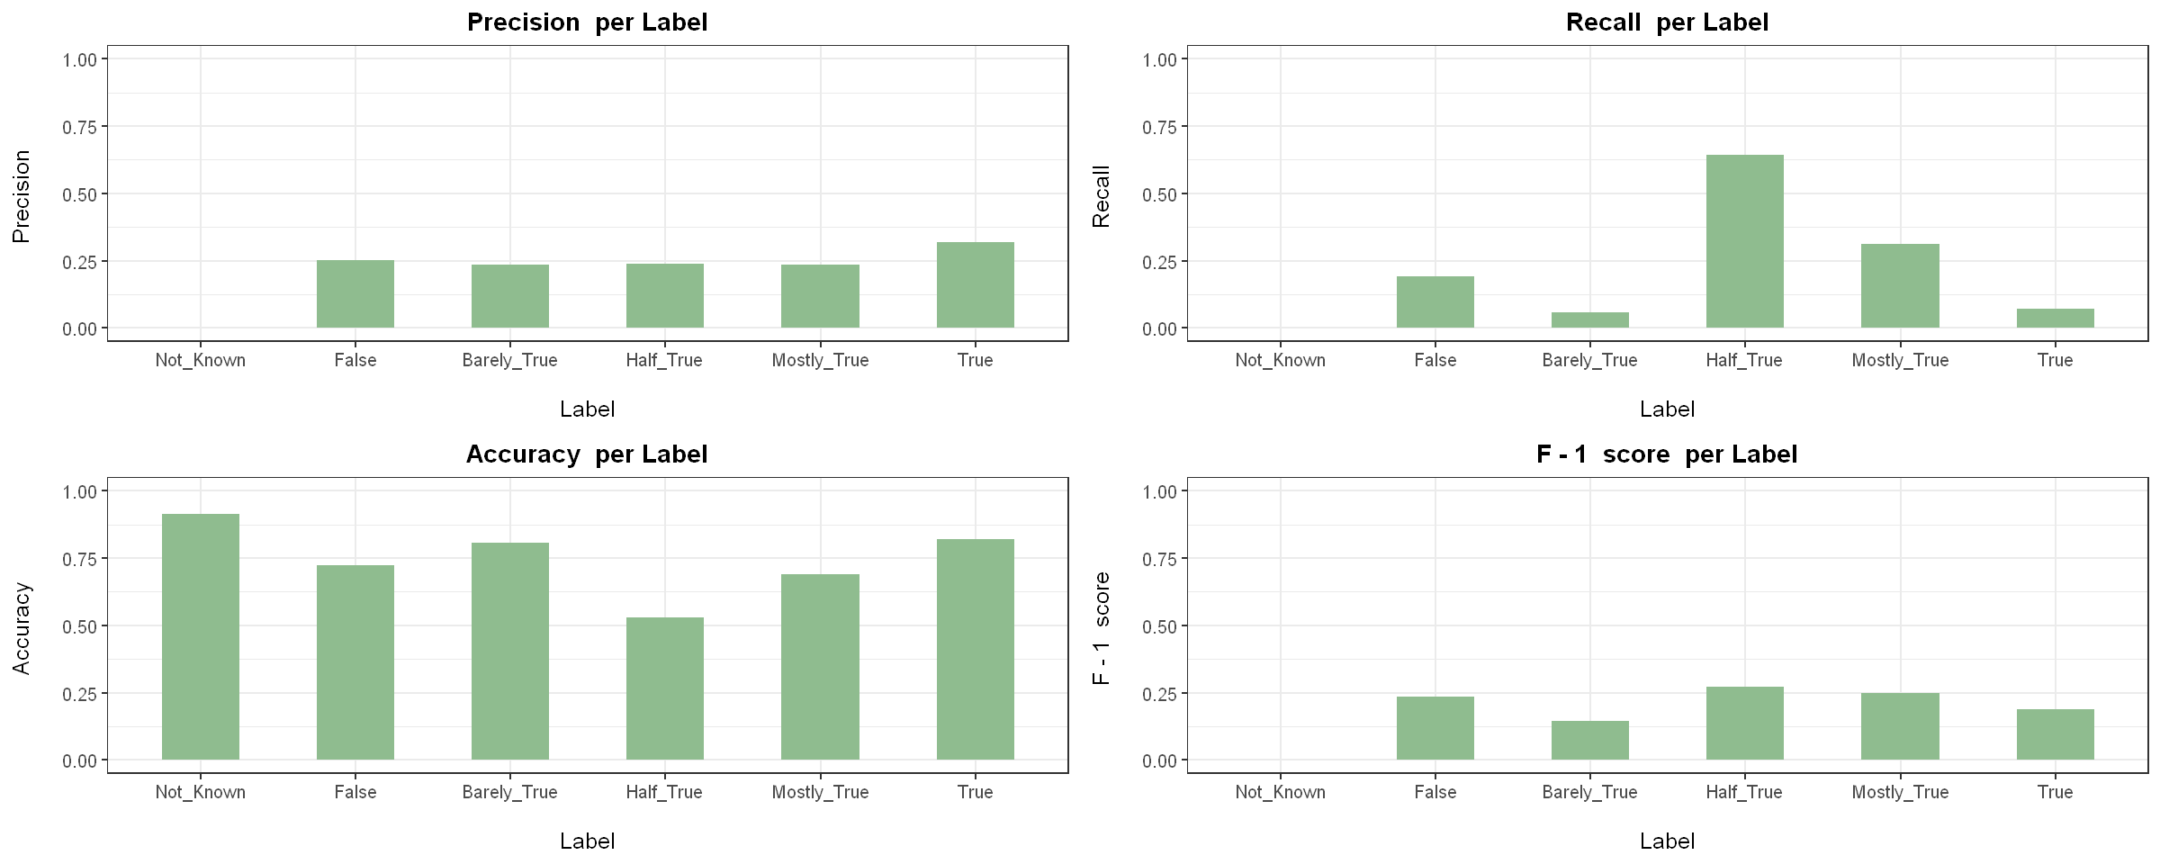
Normalization: Stemming vs lemmatization
STEM: 1, LEM: 1, FEAT: 0

Slide 7
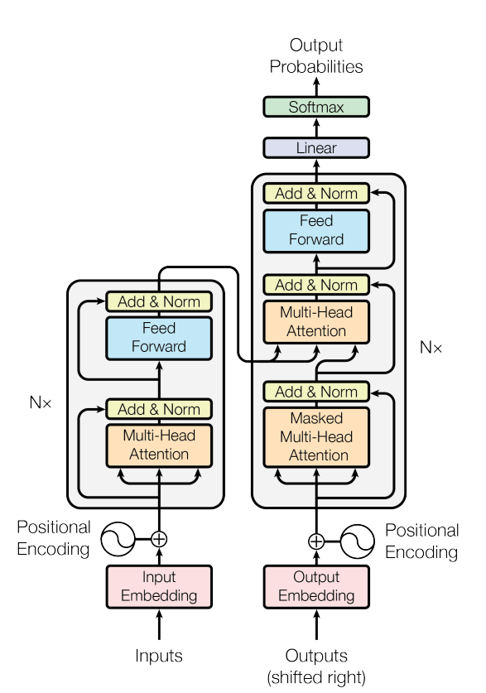
2. TRANSFORMERS
A sequence-to-sequence architecture: Transforms one sequence to another
Extensively used in Natural Language Processing, Timeseries Evaluation, etc.
Implements Attention mechanism: This looks at an input sequence and assigns importance (attention) to each section of the sequence.
Consists of two main components: Encoder (takes input and implements self-attention) and Decoder (takes in output samples and implements masked attention).

Slide 8
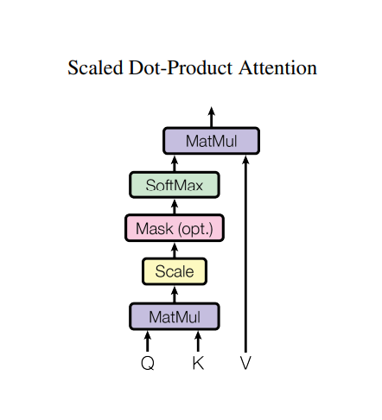
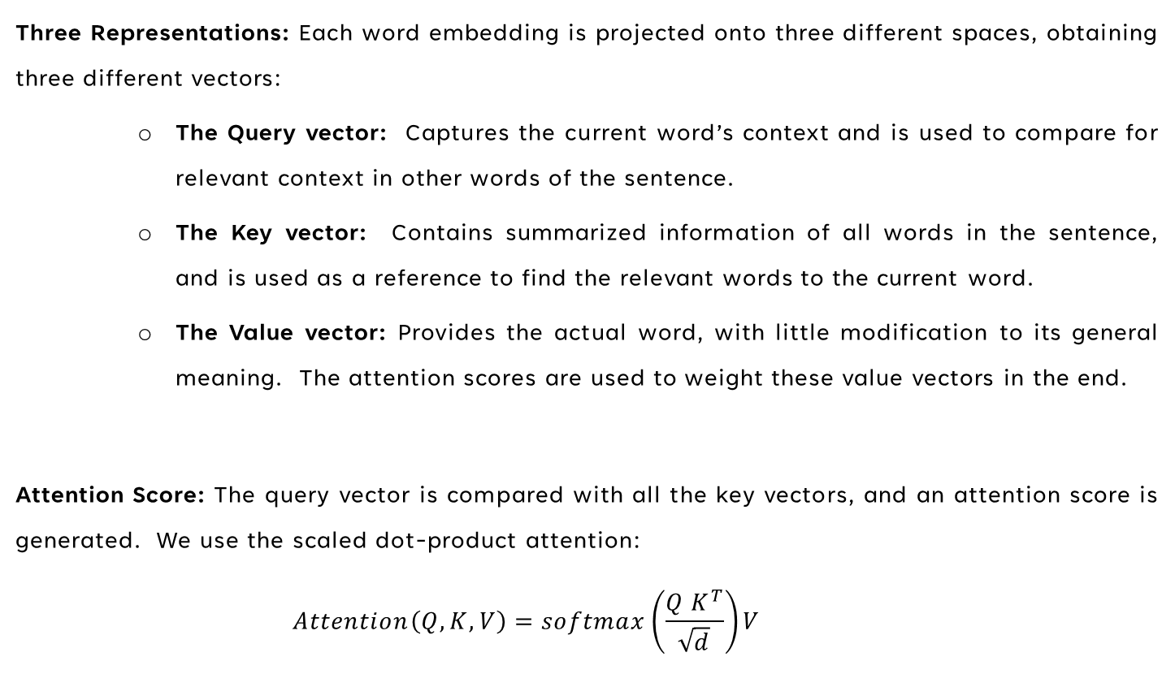
2. TRANSFORMERS – SCALED DOT PRODUCT (SELF) ATTENTION
Three Representations: Each word embedding is projected onto three different spaces, obtaining three different vectors:
The Query vector: Captures the current word’s context and is used to compare for relevant context in other words of the sentence.
The Key vector: Contains summarized information of all words in the sentence, and is used as a reference to find the relevant words to the current word.
The Value vector: Provides the actual word, with little modification to its general meaning. The attention scores are used to weight these value vectors in the end.
Attention Score: The query vector is compared with all the key vectors, and an attention score is generated. We use the scaled dot-product attention:
$$Attention\left(Q, K, V\right)=softmax\left(\frac{Q K^{T}}{\sqrt{d}}\right)V$$

Slide 9
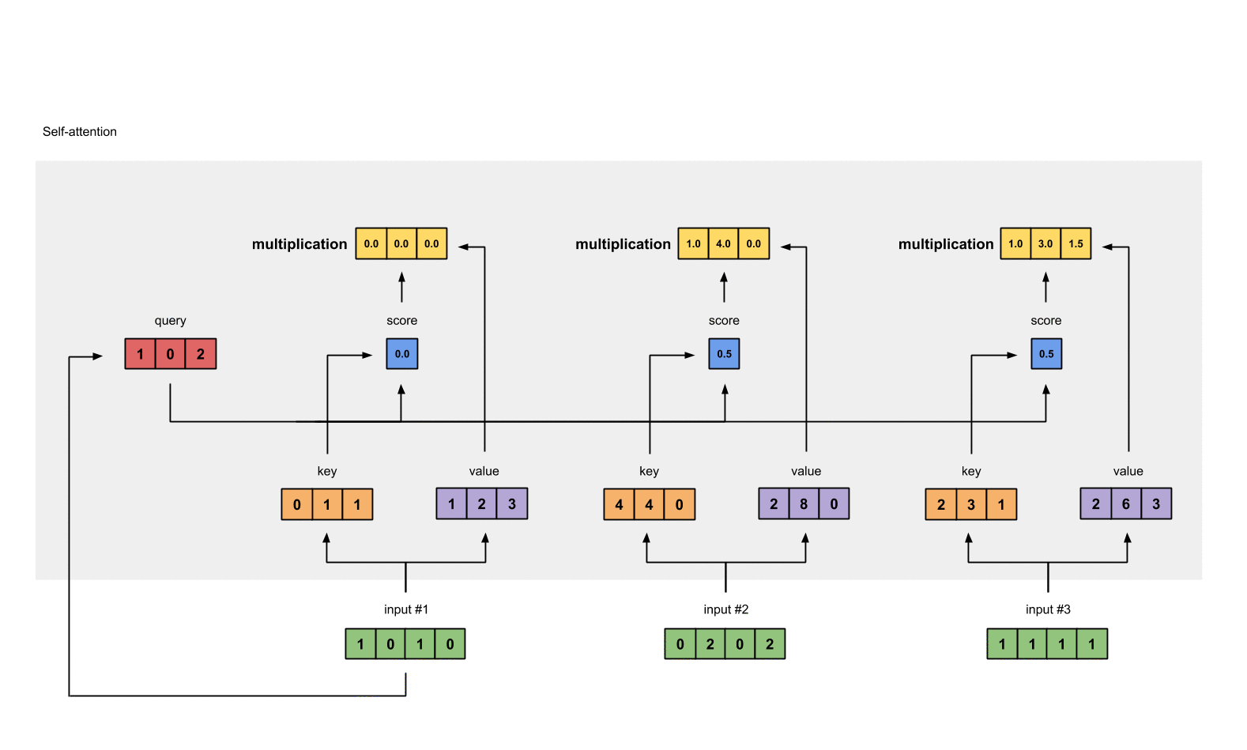
2. TRANSFORMERS – SCALED DOT PRODUCT ATTENTION

Slide 10
2. TRANSFORMERS – Natural Language Processing
Input Processing: Input sentence is received, tokenized (marking each word’s position in the input) and converted to embedded vectors (mapping the words to an embedding space to give them general context).
Encoder:
Multi-Head Attention: Applies attention to itself (self-attention) using different sets of weight matrices. The different sets define the multiple heads.
Feed Forward Network: Learns patterns using the attended and improved embeddings.
Add and Normalization: Adds the input to the result so as to maintain initial meaning or context. Normalizes the results so that the model works with equally scaled variables.

Slide 11
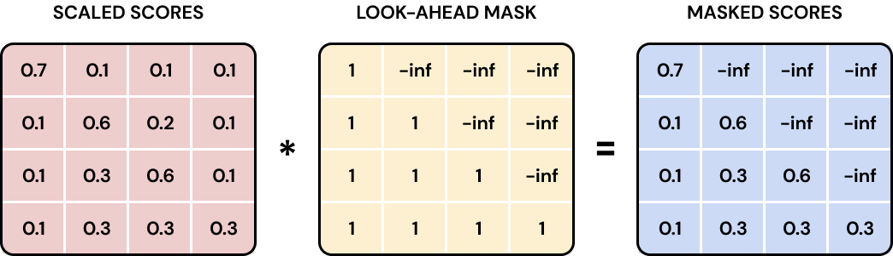
2. TRANSFORMERS – Natural Language Processing
Decoder:
Auto-regressive
Masked Multi-Head Attention: Applying self attention by masking future words. This ensures that all learning and predictions happen using current and previous data.
Second Multi-Head Attention: The encoder’s output is used as the query and key, and the first multi-head attention’s output is the value.
Output: Provides probability scores over vocabulary

Slide 12
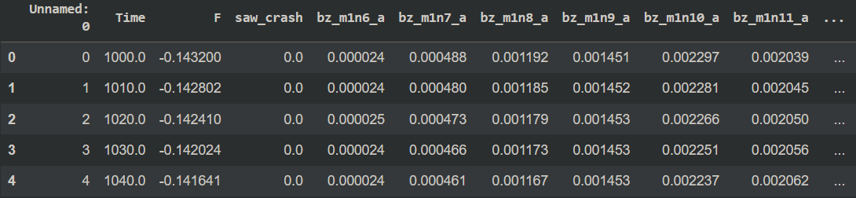
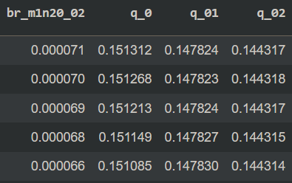
2. TRANSFORMERS – TIME SERIES DATA
In Timeseries data:
Sentence -> A selected time window of evolution of features (matrix of shape: (Time window, Row length) )
Word -> Set of features at one time instance (each row)
We use only Encoder here since we are dealing with a binary classification task
Sentence
Word

Slide 13
3. General approach
PREPARING DATA
DEFINE MODELS
Cleaning, Filtering Data
Splitting into testing and training sets
Convolutional Neural Network
Dense Neural Network
Transformers
DEFINE METRICS
Accuracy
Recall
Precision
F-Beta Score
VALIDATION AND GRID-SEARCH
IMPROVING BEST MODEL

Slide 14
3. General Approach – Confusion Matrix
True Positive: Predicting crash when actual crash is present.
False Negative: Predicting no crash when actual crash is present.
False Positive: Predicting crash when no actual crash is present.
True Negative: Predicting no crash when no crash is present.
TRUE POSITIVE | FALSE NEGATIVE
FALSE POSITIVE | TRUE NEGATIVE
1
ACTUAL LABEL
0
1
0
PREDICTED LABEL

Slide 15
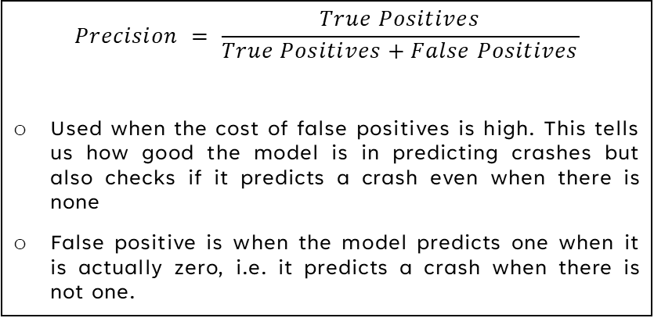
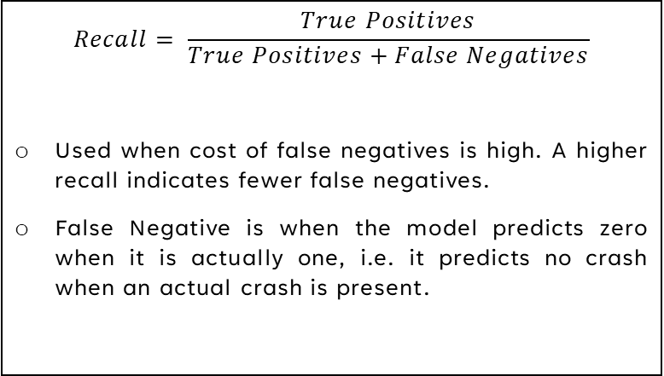
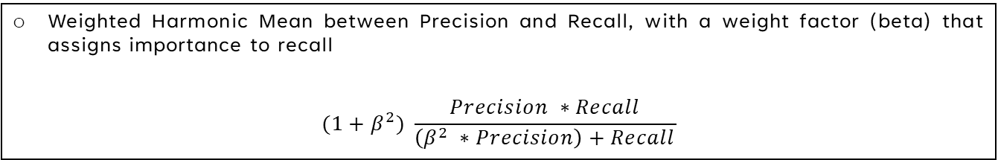
3. General Approach - metrics
recall
Precision
$$Recall= \frac{True Positives}{True Positives+False Negatives}$$
Used when cost of false negatives is high. A higher recall indicates fewer false negatives.
False Negative is when the model predicts zero when it is actually one, i.e. it predicts no crash when an actual crash is present.
$$Precision = \frac{True Positives}{True Positives+False Positives}$$
Used when the cost of false positives is high. This tells us how good the model is in predicting crashes but also checks if it predicts a crash even when there is none
False positive is when the model predicts one when it is actually zero, i.e. it predicts a crash when there is not one.
Weighted Harmonic Mean between Precision and Recall, with a weight factor (beta) that assigns importance to recall
$$(1+β^{2}) \frac{Precision ∗Recall}{\left(β^{2} ∗Precision\right)+Recall}$$
F-Beta Score:

Slide 16
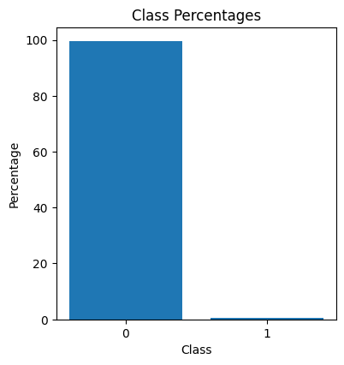
4. Challenges faced
Data imbalance
DEAD AND UNSTABLE SOLUTIONS
Large percentage of zeros as compared to ones
Percentages: ( 0: 99.5% , 1: 0.48% )
Some solutions kept predicting either 1 or zero all the time
Unreliable training, gets very different results each time
COMPUTATIONAL COSTS
Grid Search on all possible combinations not possible

Slide 17
5. Methods used
Principal component analysis
STRATIFICATION
Down-sampling of majority class
Sparse grid search
Repeated analyses

Slide 18
ii. DATA PREPARATION
Structure of Data
Preparing Data
MP vs MP-Less Analysis

Slide 19
1. Structure of data
files
columns
MP Data: With Magnetic Perturbation.
Rows: ~40000
Columns: 67
MP-Less Data: Without Magnetic Perturbation
Rows: ~40000
Columns: 67
Time stamp: Measured in Alfven units
F parameter: Reversal parameter, sudden fall near crash
Saw_crash: Binary label for crash
Toroidal Magnetic Field Instability Amplitude: 15*3 columns, each set measured at different radial positions: r=(0, 0.1a, 0.2a)
Safety Factors: 3 columns at three different radial positions

Slide 20
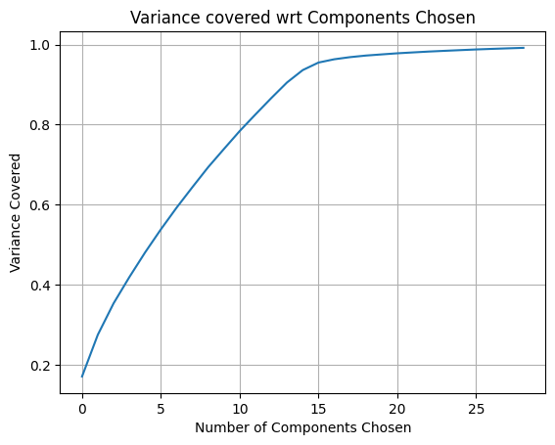
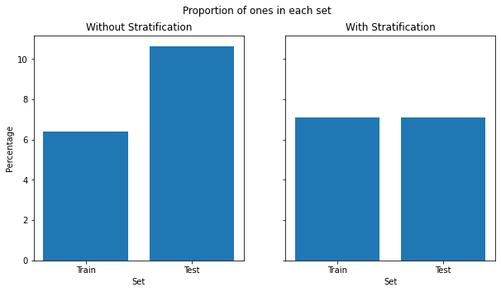
2. Preparing the data – methods used
Training and prediction windows
Down-sampling of zeros
Principal component analysis
Training Window (L): Length of window used for training
Prediction Time (dt): How long in the future we want to check for a crash
Prediction Window (WR): Checking for a crash inside window of length WR at time dt
Randomly choosing zeros with an acceptance rate of 0.2
Chose number of components such that 99% variance is explained: pca_num = 29
stratification
Maintaining equal proportion of ones when splitting the data into two sets

Slide 21
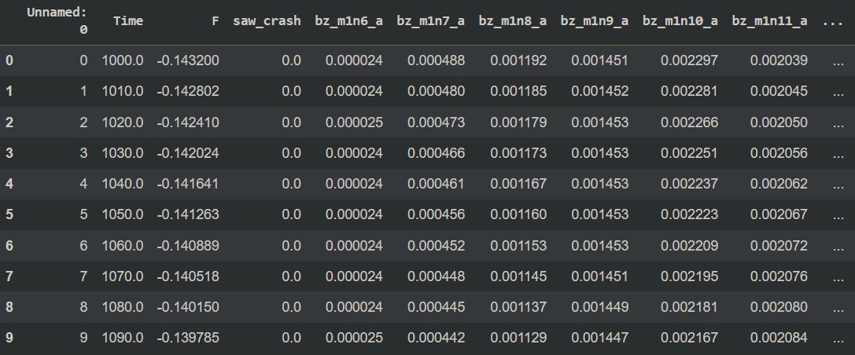
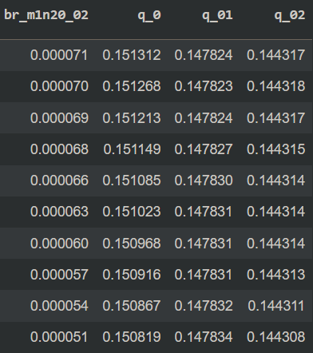
2. Preparing the data – data snippet
(L: 6, dt: 4, WR: 0)

Slide 22
2. Preparing the data – data snippet
(L: 6, dt: 4, WR: 1)

Slide 23
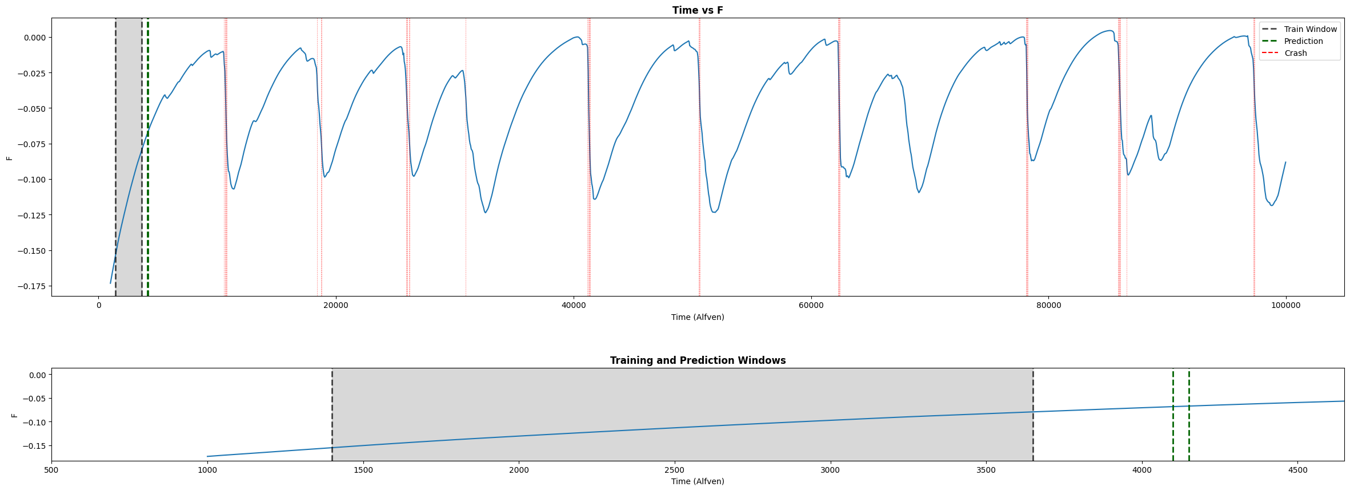
2. Preparing the data – methods used

Slide 24
3. MP vs MP-Less analysis
Two types of datasets
With magnetic perturbation
Without magnetic perturbation
The model with the best parameters is trained on each set of data and tested independently.
The results are not as satisfying compared to the trainings on the merged dataset.
Magnetic Perturbation | Applied | Not Applied
Accuracy | 77.6 % | 73.1 %
Recall | 88.9 % | 86.8 %
Precision | 9.3% | 6.5 %

Slide 25
iii. Validation among model architectures
Schema of Model Architectures
Grid Search on Models
Why Transformers
Plots and Results

Slide 26
1. Schema of model architectures
Data parameters: ( L: 30, dt: 10, Wr: 0, pca: false )
Model 1: CNN
Model 2: DNN
Model 3: Transformer
Convolutional layer
Dropout
Batch Normalization
Repeat for num_layers
Output Dense layer
Dense layers of sizes from 8 till 2048.
Dropout
Output Dense layer
Encoder (N times)
Layer Normalization
MultiHead Attention
Dropout
Residual Connection
Layer Normalization
1D Convolutional Layer
Dropout
1D Convolutional Layer
Residual Connection
Possible Dense Layers

Slide 27
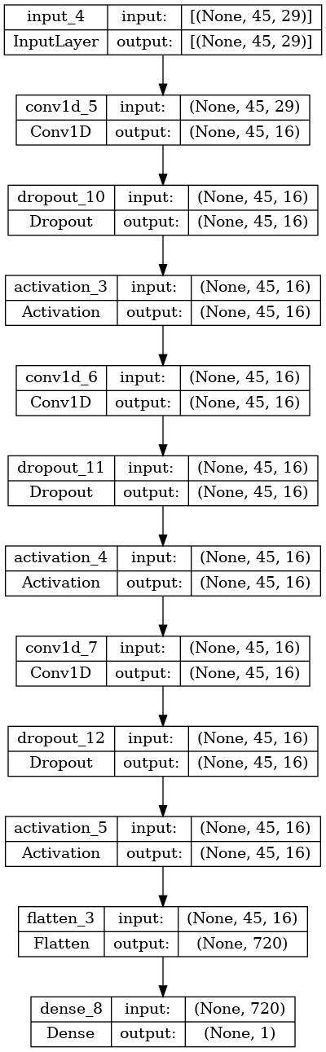
Model 1: CNN

Slide 28
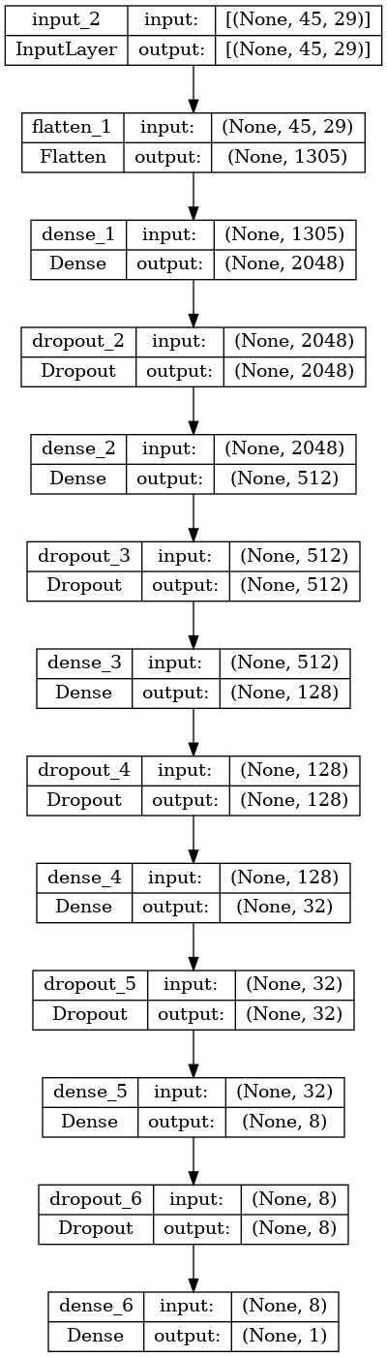
Model 2: DNN

Slide 29
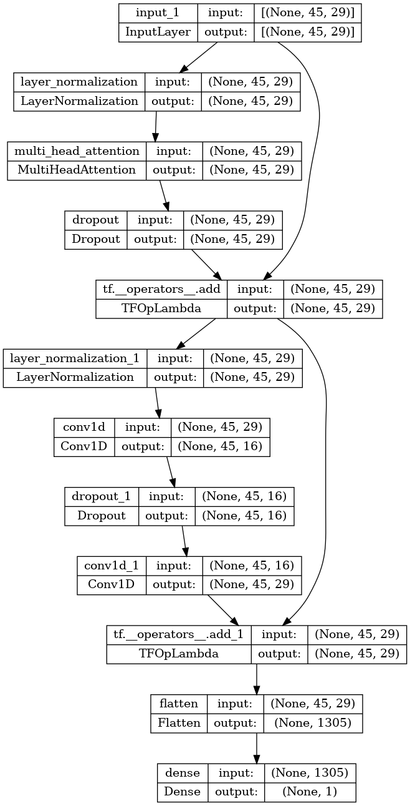
Model 3: Transformer

Slide 30
2. Grid-search (cnn) – mean values
param_act | param_do_batch_norm | param_filters | param_kernel | param_num_layers | harmonic_mean_acc_rec | Accuracy | Recall
gelu | FALSE | 16 | 2 | 3 | 0.873798 | 84.082 ± 0.53% | 89.456 ± 0.314%
gelu | FALSE | 64 | 1 | 3 | 0.868311 | 84.155 ± 0.808% | 88.496 ± 0.981%
gelu | FALSE | 16 | 1 | 3 | 0.864541 | 81.377 ± 0.788% | 89.768 ± 1.696%
gelu | FALSE | 16 | 2 | 6 | 0.86378 | 83.208 ± 1.127% | 88.37 ± 0.823%
gelu | FALSE | 64 | 2 | 6 | 0.788001 | 86.652 ± 8.541% | 74.79 ± 10.704%
All values above represent the mean values obtained when training using each model

Slide 31
2. Grid-search (Dnn) – mean values
param_act | param_dims | param_dropout | harmonic_mean_acc_rec | Accuracy | Recall
gelu | [2048, 512, 128, 32, 8] | 0 | 0.901 | 87.773 ± 0.803% | 91.603 ± 6.633%
elu | [32, 32, 32, 32] | 0.4 | 0.9 | 85.64 ± 0.758% | 92.822 ± 6.464%
relu | [32, 32, 32, 32] | 0 | 0.9 | 86.147 ± 0.739% | 92.412 ± 8.164%
elu | [32, 32, 32, 32] | 0 | 0.898 | 86.802 ± 0.842% | 91.603 ± 6.633%
gelu | [32, 32, 32, 32] | 0.2 | 0.897 | 85.482 ± 0.737% | 92.372 ± 7.095%
All values above represent the mean values obtained when training using each model

Slide 32
2. Grid-search (transformer)– mean values
param_ff_dim | param_kernel_size | param_num_transformer_blocks | param_dropout | param_head_size | param_num_heads | harmonic_mean_acc_rec | Accuracy | Recall
16 | 3 | 1 | 0.2 | 256 | 3 | 0.891 | 86.37 ± 1.116% | 90.718 ± 2.441%
32 | 5 | 5 | 0 | 128 | 3 | 0.89 | 85.896 ± 1.165% | 90.883 ± 1.199%
4 | 3 | 1 | 0.5 | 512 | 3 | 0.889 | 80.904 ± 6.021% | 94.365 ± 4.851%
4 | 5 | 1 | 0.5 | 128 | 5 | 0.888 | 85.012 ± 3.329% | 91.139 ± 2.968%
16 | 1 | 1 | 0 | 512 | 3 | 0.886 | 86.286 ± 4.085% | 89.949 ± 6.178%
All values above represent the mean values obtained when training using each model

Slide 33
2. Grid-search – Best values found
Model | Accuracy ± std | Recall ± std
CNN | 0.84 ± 0.005 | 0.89 ± 0.03
DNN | 0.88 ± 0.08 | 0.91 ± 0.06
Transformer | 0.86 ± 0.01 | 0.91 ± 0.02
Overall, comparing all these three models, Transformer has the better performance and CNN shows the least desirable performance.

Slide 34
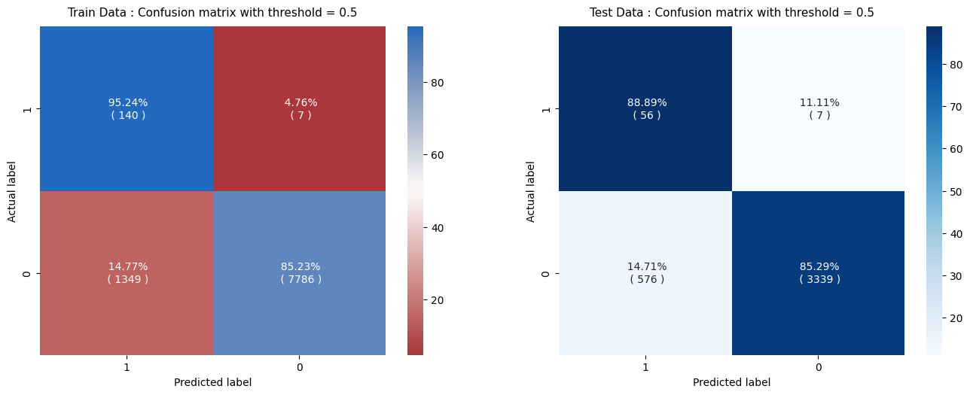
2. Grid-search comparison: training on best CNN model

Slide 35
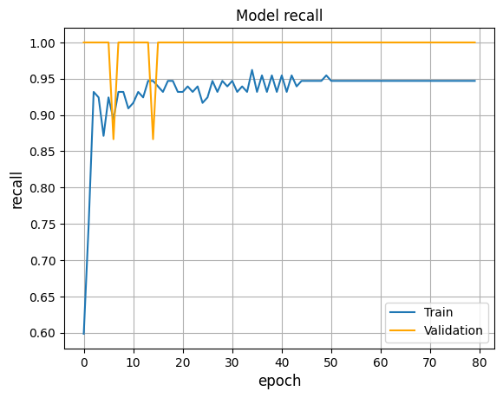
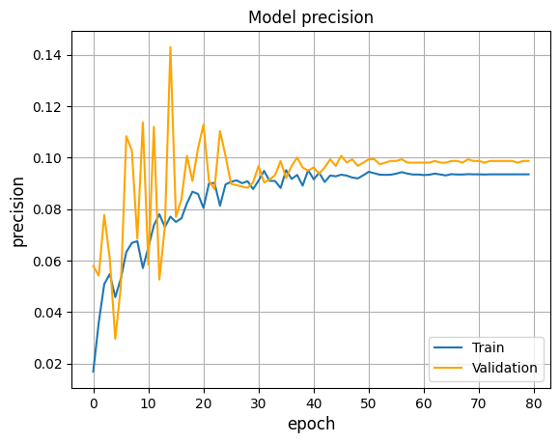
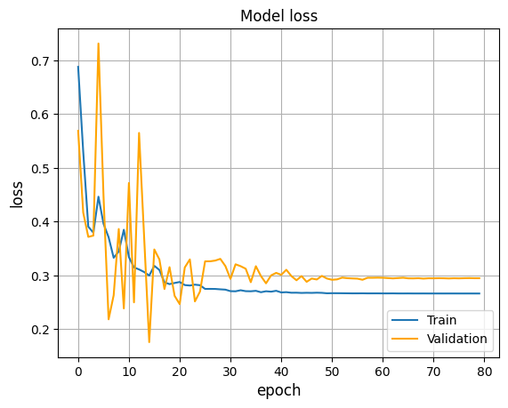
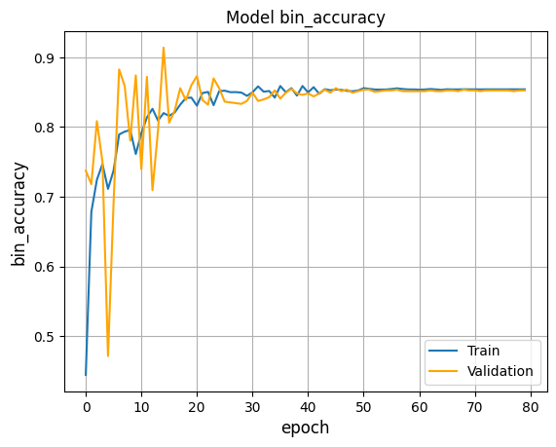
2. Grid-search comparison: training on best CNN model

Slide 36
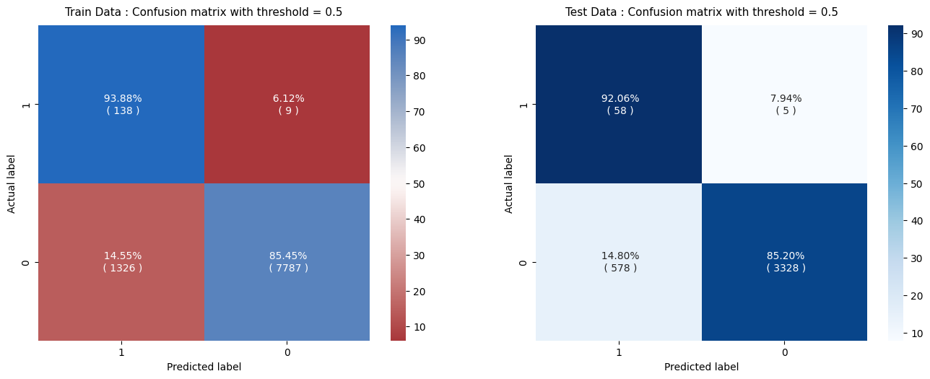
2. Grid-search comparison: training on best DNN model

Slide 37
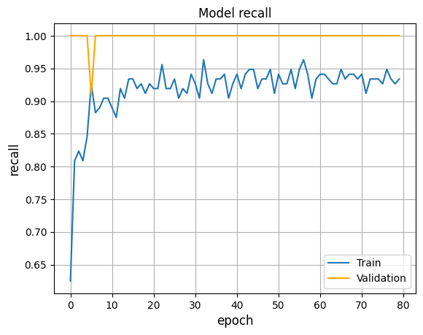
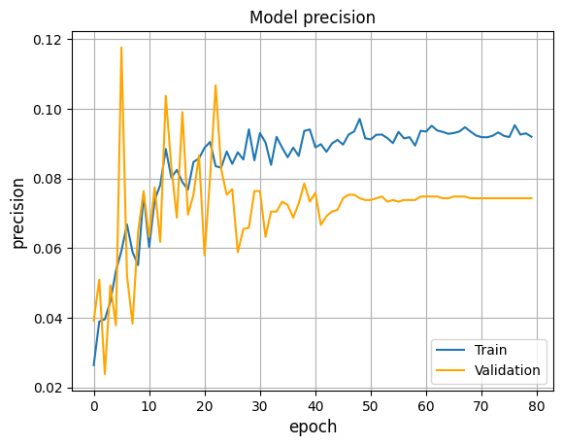
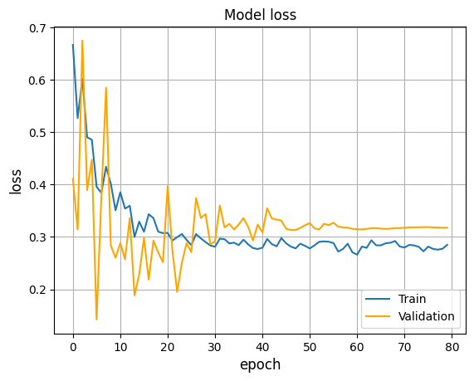
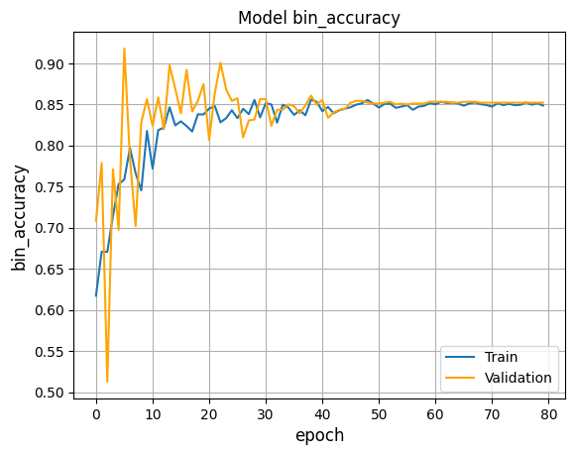
2. Grid-search comparison: training on best DNN model

Slide 38

2. Grid-search comparison: training on best transformer model

Slide 39
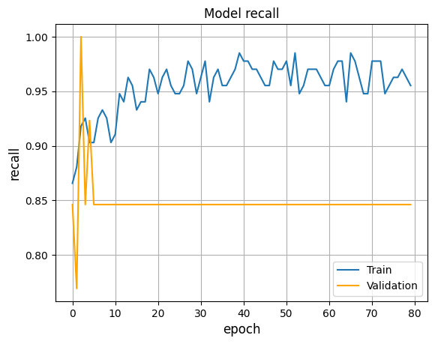
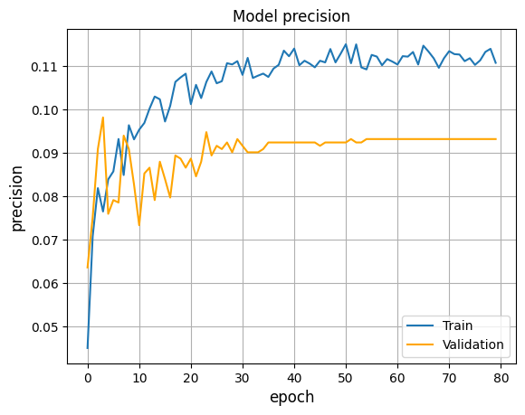
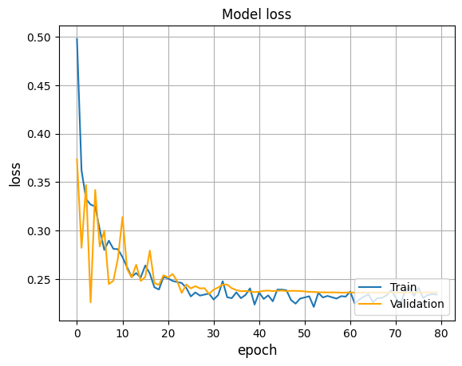
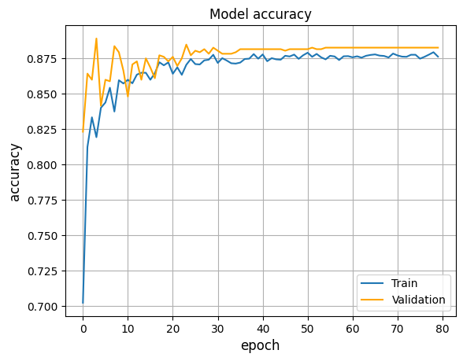
2. Grid-search comparison: training on best transformer model

Slide 40
3. Why transformers
Mean results
Standard deviation
Better Accuracy
Better Recall
Better Precision
Transformers had comparable values to CNN, signifying the reliability of the model

Slide 41
iv. Improvement of best model
Grid-Search on parameters
Heatmap Visualization on Results
Behaviour across long times
Threshold Moving
Final Results

Slide 42
1. Grid-search on parameters
objective
Values used
Optimal set
Select optimal set of data parameters:
Window Length (L)
Prediction Length (dt)
Prediction Window (WR)
Applying PCA
L: [15, 30, 45, 60, 75, 90]
dt: [10, 25, 40, 55, 70, 85]
WR: [0, 1]
PCA: [False, True]
L: 45
dt: 10
W: 1
PCA: True

Slide 43
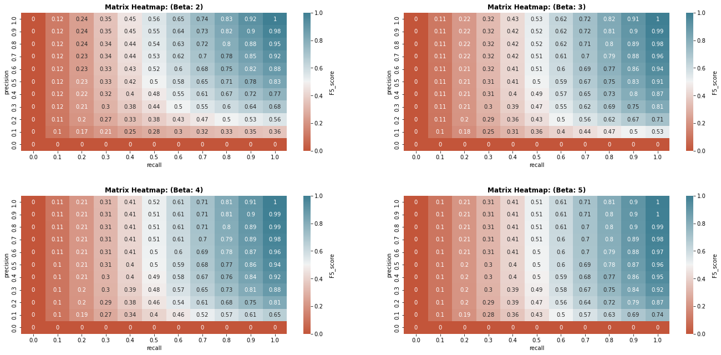
2. heatmap visualization of results – The f-beta score
Weighted Harmonic Mean between Precision and Recall, with a weight factor (beta) that assigns importance to recall
Notice how the plot starts out as horizontal for low beta and slowly starts leaning vertical as beta increases. This signals recall’s increasing impact on the metric.

Slide 44
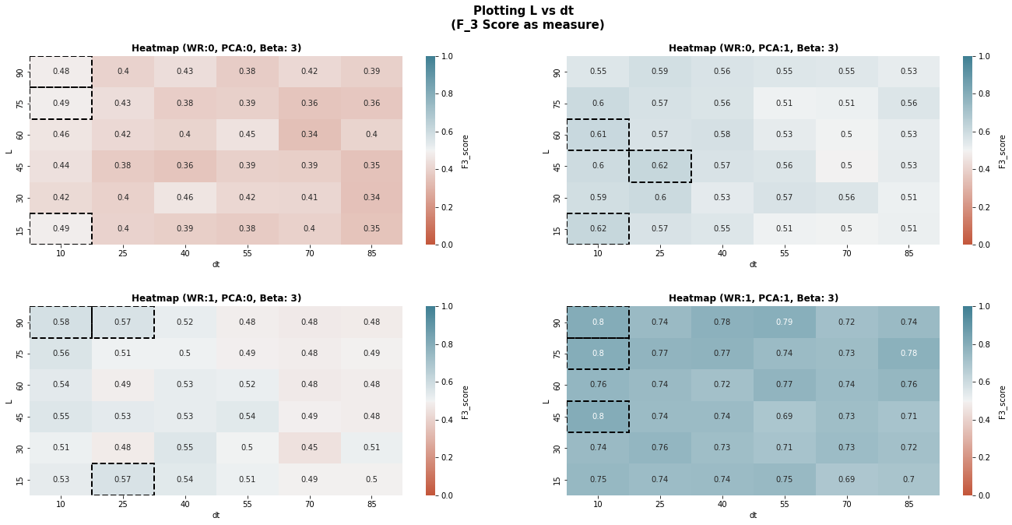
2. heatmap visualization of results

Slide 45
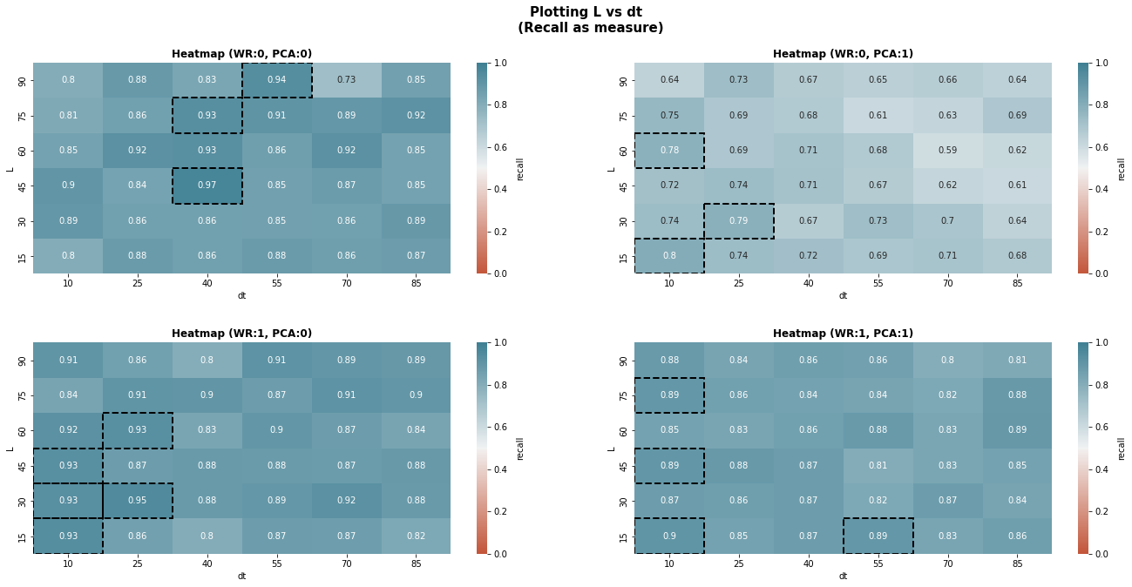
2. heatmap visualization of results

Slide 46
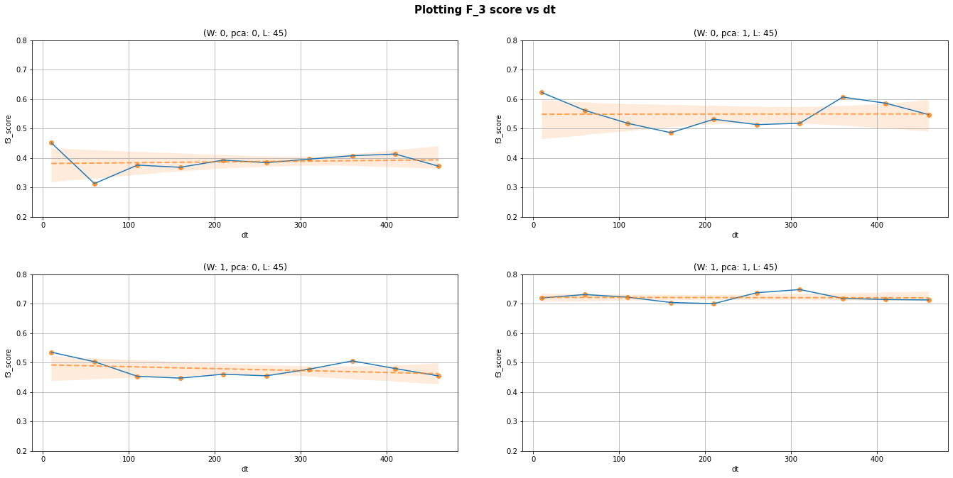
3. Behaviour across long times

Slide 47
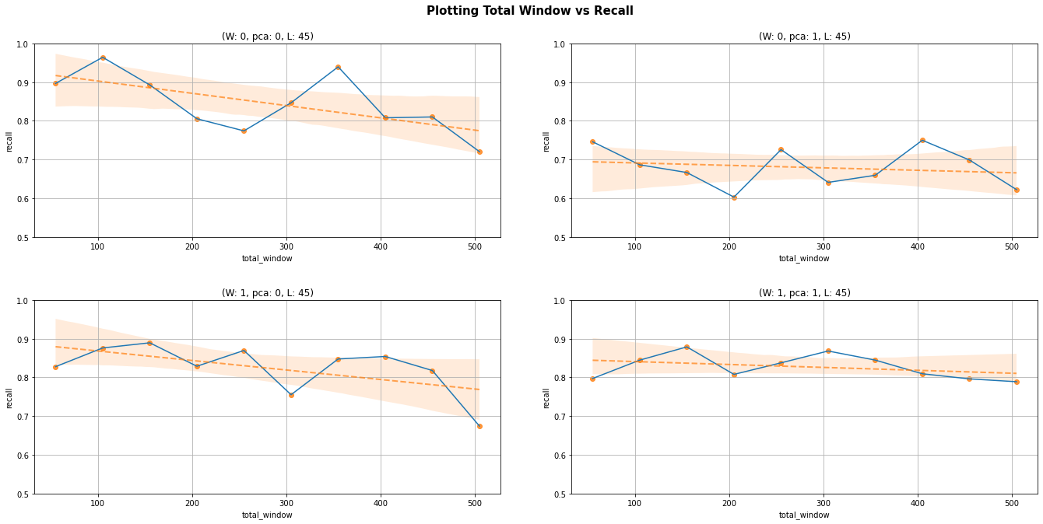
3. Behaviour across long times

Slide 48
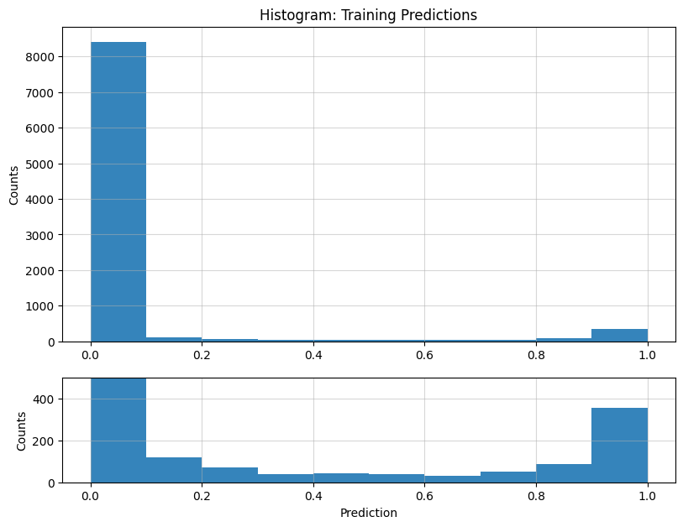
4. Threshold moving
Why move the threshold?
Usually, in binary classification problems, the threshold is set to 0.5
But with highly imbalanced data here, this might not be optimal. Moving the threshold helps us find a better balance between correctly identifying the minority class (increasing recall) while keeping an acceptable amount of false positives (precision).
Lowering the threshold makes the model more sensitive to the minority class (ones): (High recall, low precision)
Increasing the threshold makes the model behave inversely, preferring precision over recall.
Moving the threshold to a lower or upper extreme can incentivize the model to just predict ones or zeros all the time. Thus, we need to take into account this too.

Slide 49
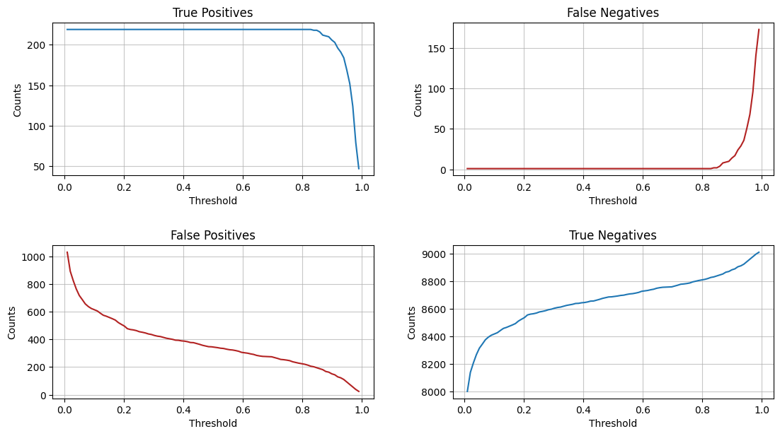
4. Threshold moving - Variation

Slide 50
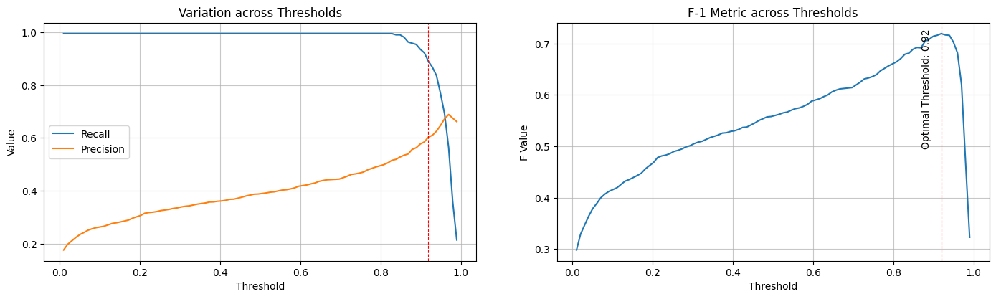
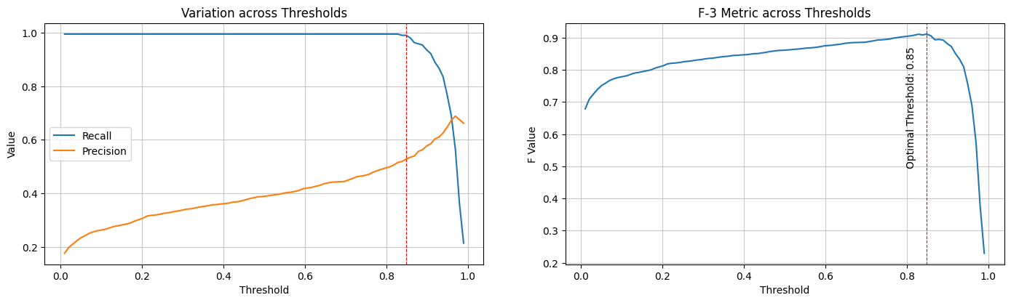

Slide 51
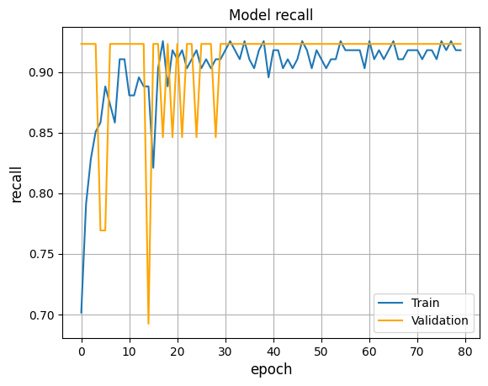
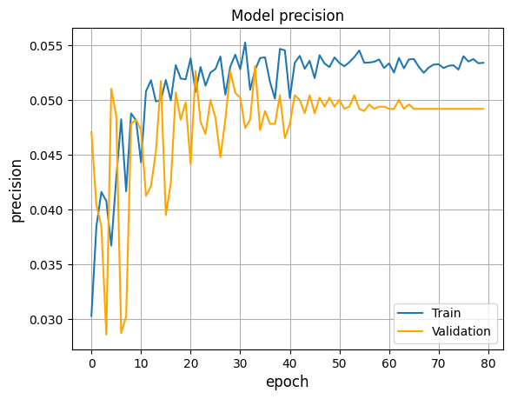
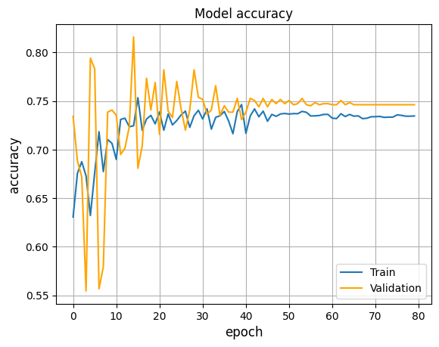
5. Improved results of best model (Before Improvement)
Data parameters: (WR:0, pca:false, l:45, dt: 10)

Slide 52
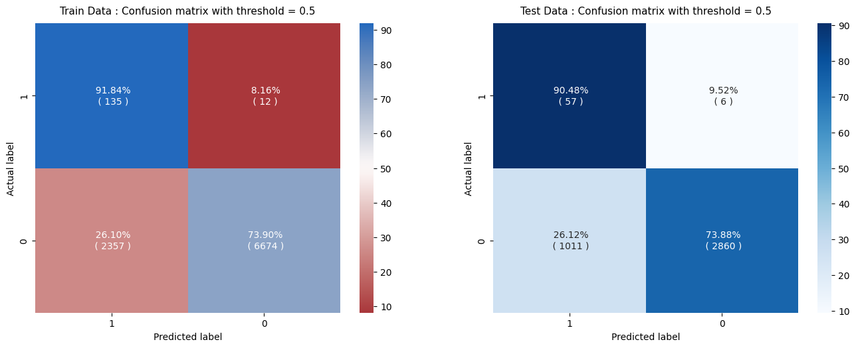
5. Improved results of best model (Before Improvement)
Data parameters: (WR:0, pca:false, l:45, dt: 10)
Threshold: 0.5

Slide 53
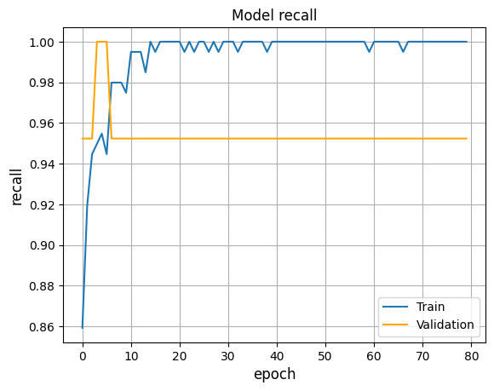
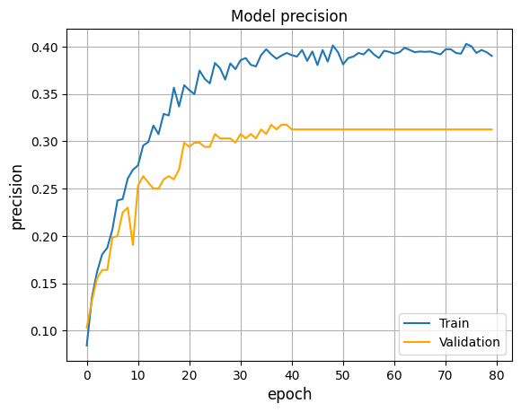

5. Improved results of best model (After Improvement)
Data parameters: (WR:1, pca:true, l:45, dt: 10)

Slide 54

5. Improved results of best model (After Improvement)
Data parameters: (WR:1, pca:true, l:45, dt: 10)
Threshold: 0.5

Slide 55

5. Improved results of best model (After Improvement)
Data parameters: (WR:1, pca:true, l:45, dt: 10)
Threshold: 0.005

Slide 56

5. Improved results of best model (After Improvement)
Data parameters: (WR:1, pca:true, l:45, dt: 10)
Threshold: 0.83

Slide 57
v. conclusion

Slide 58
Conclusion
We have successfully found a good model that is able to predict an incoming crash in a time-series
Faced with challenges like highly imbalanced data and dead solutions, we utilized a variety of methods (PCA, Stratification, Class weights, etc.) to overcome them.
Doing Grid Search with models and parameters enabled us to find out the optimal model and parameters suitable for this task. With the help of metrics and plots, we were able to quantify and visualize the comparisons.
Transformers with PCA work best along with the ability to choose Thresholds and WR, which can be tuned according to practical needs.
This problem can be extended beyond transformers by using experimental models that might show even better performance.

Slide 59
THANK YOU
GROUP 2315

Slide 60
references
Keras References: Time Series Classification , Text Classification
Illustrated Guide to Transformers
Illustrated Self Attention
F-Beta score reference
Data Imbalance reference

